Slide 1

Overview of Resources for the Emergency Management Professional
Presented:
by
Notes:
Last updated: Feb. 2023

Slide 2
About IAEM
Founded in 1952
International non-profit organization dedicated to promoting the goals of saving lives and protecting property during emergencies and disasters
More than 6,000 members worldwide
Practitioners at all levels of government, the military, private industry, volunteer organizations, campuses, healthcare institutions and more

Slide 3
IAEM’s Mission
IAEM’s Vision
That the International Association of Emergency Managers be recognized globally as the premier organization for emergency management.
The mission of IAEM is to advance the profession by promoting the principles of emergency management; and, to serve its members by providing information, networking, and development opportunities.

Slide 4
POEM
Emergency management is the managerial function charged with
creating the framework within which communities reduce vulnerability
to hazards and cope with disasters.
Comprehensive,
Progressive,
Risk-driven,
Integrated,
Collaborative,
Coordinated,
Flexible,
Professional
Notes:
Since one of the components of our mission is to promote principles of emergency management, I wanted to take a moment to define them for you.
(read slide).
The programs that presented today have certainly demonstrated these principles while facing tremendous adversity and I applaud your work.
IAEM’s mission is to support these principles.

Slide 5














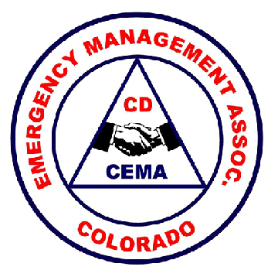


Advancing our Profession Through Partnerships
Notes:
We use partnerships to accomplish our mission.
Here are just a few of our IAEM partners, which also include state emergency management associations across the U.S.

Slide 6
IAEM’s Value Proposition
& Commitment
IAEM connects people and ideas to inspire leadership, achievement and collaboration within the emergency management profession.
IAEM provides exceptional experiences, a vibrant community, and essential tools that make you and your organization more successful.

Slide 7
Global Board of Directors
Representatives from each of the three (3) IAEM Councils participate:
IAEM Canada
IAEM Oceania
IAEM USA (4 members)
And (4) Ad Hoc Members
IAEM Asia
IAEM Middle East
IAEM Latin America
IAEM Japan
Notes:
The Ad Hoc groups do not have enough members to be a Council but they are non-voting members on the Global Board

Slide 8
IAEM-USA Board of Directors
President*
First Vice President*
Second Vice President*
Immediate Past President*
Secretary*
Treasurer*
Regional Presidents (10)
(*Executive Committee, plus one representative selected from and by the Regional Presidents)
Notes:
Puerto Rico is part of IAEM-USA Region 2. We are currently offering a special membership rate for Puerto Rican emergency managers, which I will tell you more about in a few minutes.

Slide 9
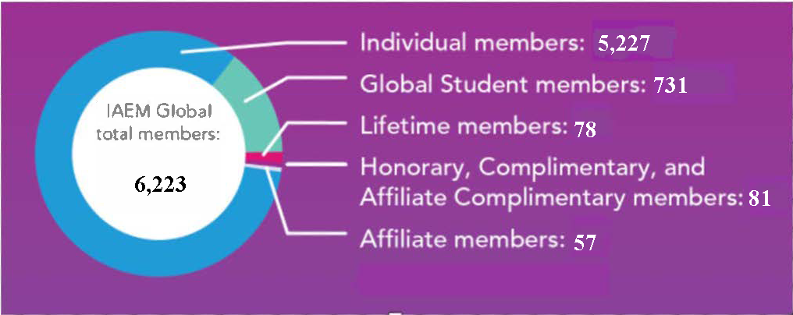
Membership Report

Slide 10
USA Standing Committees
Awards & Recognition
Bylaws
Conference
Diversity, Equity & Inclusion
Editorial
EMEX Advisory
Government Affairs
Membership
Nominations & Credentials
Training & Education

Slide 11
USA Caucuses
K-12 Education
Mental Health & Wellness
Mitigation, Climate Resilience & Adaptation
Municipal Emergency Management
Partnership
State Emergency Management Associations
Transportation
Tribal Affairs
Uniformed Services
Universities & Colleges
Weather
Accessibility & Whole Community
Advocacy and Awareness
Allied Professionals
Children and Disaster
Critical Infrastructure & Business Continuity
Disaster Cost Recovery & Finance
Emerging Professionals
Emerging Technology
Faith-Based Organizations
Healthcare
Higher Education Academician

Slide 12
USA Commissions
Certification
Scholarship

Slide 13
Connect with IAEM
IAEM Webinars — https://www.iaem.org/Events/IAEM-Webinars
IAEM website — https://www.iaem.org/
IAEM Conference microsite — https://www.iaem.org/usconf/
Facebook, LinkedIn, YouTube, Twitter, and discussion boards
IAEM Dispatch — http://iaemdispatch.com
IAEM Bulletin monthly members-only newsletter — http://www.iaem.org/Bulletin
Notes:
IAEM Webinars occur about every other month, free to IAEM members. Non-members can now participate by paying a fee to attend, with the opportunity to use the fee as a credit toward Individual membership if they join within one year.
Webinars are supplemented by IAEM Think Tank events about quarterly, with more events scheduled. They are free to the public, while IAEM members have access to event recordings.
The IAEM website — http://iaem.com — features home pages for each IAEM Council and displays the extent of IAEM’s activities, advocacy, and influence. Online resources continue to grow.
The IAEM Conference microsite — https://www.iaem.org/usconf/ — provides one portal for all annual conference and EMEX information.
The IAEM presence on social media includes active, professional use of Facebook, LinkedIn, YouTube, Twitter, and discussion boards.
The IAEM Dispatch — http://iaemdispatch.com — IAEM’s weekly e-newsletter sent to IAEM members and other interested subscribers, now totaling almost 17,000 EM professionals.
The IAEM Bulletin monthly members-only newsletter — http://iaem.com/Bulletin — an online publication including feature articles covering issues of a wide scope to reflect the diversity of IAEM membership.

Slide 14
IAEMconnect
IAEM members-only community
Easy communication between members
Special interest groups may be created quickly for urgent topics
Members share resources
Networking and Mentorship 24/7/365 in the online community

Slide 15


Mark Your Calendar for Learning Opportunities
IAEM 71st Annual Conference & EMEX
in
Long Beach, CA!
November 3-9, 2023
Notes:
IN 2020 we had:
1,542 Conference Attendees
18 Countries
44 Companies at EMEX

Slide 16
Our Advocacy
Maintained the baseline appropriation level for EMPG at $355 million per year
Secured additional funding for CEM and EMAP
Advocated for and received an additional $100 million for EMPG
Maintained baseline appropriation levels for all of FEMA’s Preparedness Grant Programs
Testified on Capitol Hill regarding disaster housing
Successfully defeated a proposal to dismantle the Stafford Act
Helped draft and endorsed the Community Disaster Resilience Zones Act, the Post Disaster Mental Health Support Act, the Real Emergency Access for Aging and Disability Inclusion for Disasters Act, and the FEMA Equity Act.

Slide 17
Advancing our Profession Through Standards
AEM/CEM: IAEM offers a certification program for individuals, the Certified Emergency Manager (CEM) & Associate Emergency Manager (AEM) program.
EMAP: IAEM, along with NEMA, supports the Emergency Management Accreditation Program (EMAP) which supports accreditation of EM programs.

Slide 18
Emergency Management Accreditation Program
The design facilitates determination of compliance with a collaboratively developed set of Standards called the Emergency Management Standard.
A voluntary, non-governmental process of self-assessment, documentation, and external independent peer review with the focus to evaluate, enhance, and recognize Program sustainable qualities.
The intent is to improve Program capabilities and increase professionalism.
Accreditation evaluates an Emergency Management program’s organization, resources, plans, and capabilities against current Standards to increase effectiveness in protecting the lives and property of the people it serves.

Slide 19
Certification: Advancing Our Profession
In 1993 IAEM created the internationally recognized Certified Emergency Manager (CEM®) program.
In 1997 IAEM created the internationally recognized Associate Emergency Manager (AEM®) program.
As of February 1, 2023, there were 2,211 Certified Emergency Managers and 305 Associate Emergency Managers.
Notes:
The certification program was developed by a Professional Standards Advisory Council of subject matter experts representing all aspects of emergency management and related fields, and with input from organizations representing regulators and those who hire, supervise and fund emergency management programs such as FEMA, ICMA, ASPA, APWA and other professional organizations.

Slide 20
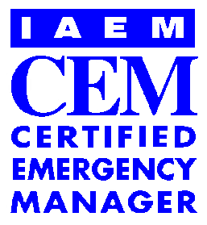

Purpose of IAEM’s Certification Program
Elevate the visibility of emergency managers.
Encourage and mandate continued professional development, education, and technical skills.
Career enhancing credential

Slide 21

Areas of Expertise on CEM Commission
Governmental– all levels
Private Sector
Military
Not-for-Profit
International
Campus Practitioners
Academia / Educators
Healthcare Practitioners

Slide 22
Why Become an AEM or CEM?
A Certified Emergency Manager (CEM®) has the knowledge, skills, and ability to effectively manage a comprehensive emergency management program.
Working knowledge of all the basic tenets of emergency management.
Effectively accomplish the goals and objectives of any emergency management program in all environments with little or no additional training orientation.

Slide 23
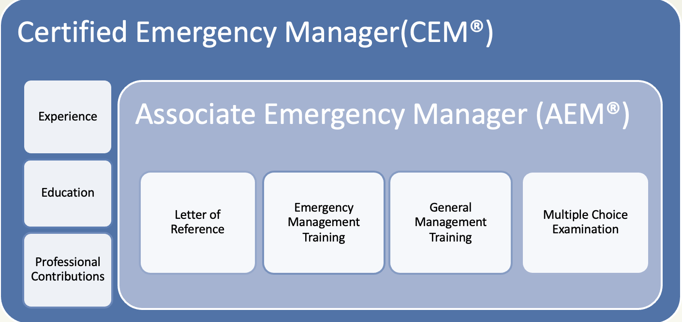
Certification Requirements

Slide 24
AEM Requirements
Training – 100 hours of General Management Training
Training – 100 hours of Emergency Management Training
Reference – one letter, plus contact info for two other references
Examination – 120-question multiple choice
Notes:
100 each EM and GM, within last 10 years
Additional letters allowed if candidate feels it would be helpful in their review
75% correct for exam
ESSAY PROMPT: Should be easy given your experiences this year. “You are the new emergency manager for an organization. After reviewing existing plans, after action reports, and training records, your first task is to develop and present a written description of a specific problem and how you would solve it to enhance resiliency and provide for continuity.”

Slide 25
CEM Requirements
In addition to the AEM requirements, those seeking CEM must document:
Work History – 3 years of comprehensive EM work
Work Experience – Full scale exercise, two functional exercises, actual disaster or major public event
Education – A baccalaureate degree from an accredited institution (US, Europa, Oceania Applicants)
  Substitute 2 years FTE per year of college (Asia, International, Latin America & Caribbean)
  Canada candidates must submit any 3 or 4 year bachelors degree or any post-graduate degree in emergency management or related field
Professional Contributions – 6 separate categories
Notes:
FT, full-scale exercise or actual disaster (degree in EM reduces this requirement)
Caribbean education may substitute 2 years experience per year of university

Slide 26

AEM/CEM Examination Design
120 Multiple Choice Question Exam
60% - 80% Core Questions
20% - 40% Country- or Region- Specific Questions
The passing score is 500 on a scale of 200 to 800.
Pass Exam BEFORE or AFTER Application Submission
Notes:
Moving forward, IAEM will determine exam results using a scaled score reporting. Scaled scoring is a representation of the total number of correct answers a candidate has provided that has been converted into a standardized scale.

Slide 27
Certification Maintenance
AEMs and CEMs maintain certification every five years
Document continuing education in both general management and emergency management
Professional contributions

Slide 28
AEM/CEM Highlights
AEM and CEMs are found in 23 countries (50 states in the U.S. and 3 territories)
We have CEMs from multiple disciplines, including fire, police, medical, education, etc.
IAEM conducted an updated job task analysis in 2021 to verify the certification KSAs match EM job duties.
In 2022, IAEM revised certification exam questions to align with the job task analysis using input from subject matter experts.

Slide 29
Tools and Support
IAEM Certification Website Tools
  Self-Assessment Tool
  Exam Study Guide
  Training Allocation Chart
  FAQ
  Application Guidebook
  Recorded Certification Webinar Series
Support
  Mentors
  In-person Prep Course
  Online Prep Course through MindEdge Learning
  Questions → info@iaem.com
Notes:
We were able to deliver a prep course to BVI in April 2017. we are grateful for Sharleen DeBreo and Dr. Evangeline Innes for allowing us to provide onsite work with their team to seek the Certification.

Slide 30
Mentor Program
IAEM compiled a list of CEMs eager to help candidates in the certification application process.
Online database searchable by location or employment description
Consider job title, organization, sector of practice, certification date, and biography
Notes:
Currently over 200 on the list but mentors need not be limited to those on the list – you can also request a CEM with whom you have a relationship

Slide 31
Because people’s lives depend on you…
You can depend on IAEM
Largest network of experts offering solutions, guidance and assistance;
Job opportunities – extensive online compilation;
Unified voice on policies and legislation;
Information updates via monthly newsletter and regular electronic notices;
Professional tools and resources on www.iaem.org;
Certified Emergency Manager and Associate Emergency Manager;
Scholarship program;
And much more!

Slide 32












Connect with Us!
@IAEM, #iaem
@IAEM_org
Notes:
You can connect with us on our various social media accounts and share your virtual conference!

